Slide 1

LENDING CLUB CASE STUDY AMANDEEP MINHAS ARUN VINCENT J A

Slide 2
PROBLEM
Lending Club is the largest online loan marketplace, facilitating personal loans, business loans, and financing of medical procedures.
COMPANY PROFILE
Lending Club wants to understand the driving factors behind loan default, i.e. the driver variables which are strong indicators of default.
So as a data scientist working for Lending Club, we have to analyze the dataset containing information about past loan applicants using EDA to understand how consumer attributes and loan attributes influence the tendency of defaulters.
PROBLEM

Slide 3
APPROACH
DATA CLEAN
Clean the data by dropping the columns with null values
UNIVARIATE ANALYSIS
Analyze the distribution of the categorical variables and create the derived variables
BIVARIATE ANALYSIS
Do a correlation analysis between two variable
From the analysis and the observations publish the findings
RECOMMENDATION

Slide 4
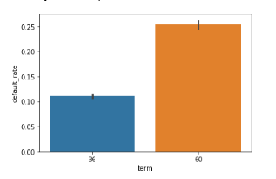
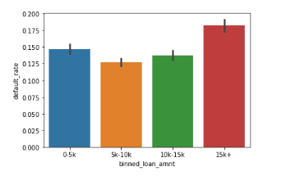
ANALYSIS
Term Analysis
11% of the loans taken for a term of 36 months defaulted.
25% of the loans taken for a term of 60 months defaulted.
Analysis with respect to Loan Amounts
Most of the loans provided are approximately between 5k to 15k.
~13% of the loans lent in this range tend to default.
~18% of the customer who borrow more than 15k tend to default.
~15% of the customer who borrow less than or eq to 5k tend to default.

Slide 5
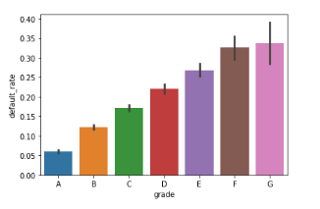
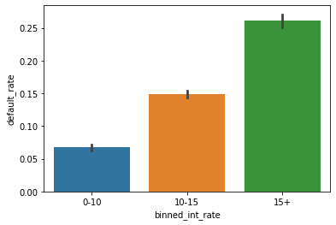
ANALYSIS
Grade:
As expected, as the grade increases, the risk or default increases as well.
Analysis with respect to Interest Rate
~ low ~6% default when interest rate is less than 10%.
~ Medium ~15% default when interest rate is between 10% to 15%.
~ High ~26% default when interest rate is above 15%.
Interest Rate and Tendency to Default are directly proportional. As one increases, other increases as well.

Slide 6
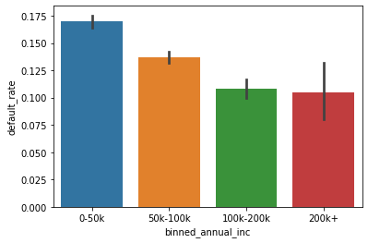
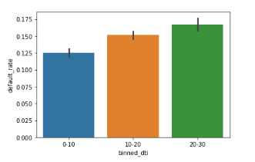
ANALYSIS
Analysis with respect to Annual Income
As income increases, the chances of customer defaulting decreases.
~17% of customers with annual income of less than USD 50k tend to default.
~13% of customers with annual income between USD 50k to USD 100k tend to default.
~10% of customers with annual income between USD 100k to USD 200k tend to default.
~10% of customers with annual income above USD 200k tend to default.
Analyze DTI:
After Creating buckets for DTI ranging from 0-10, 10 to 20 and 20 - 30 and plot against default rate it is observed that as DTI increases, the tendency to default increases

Slide 7
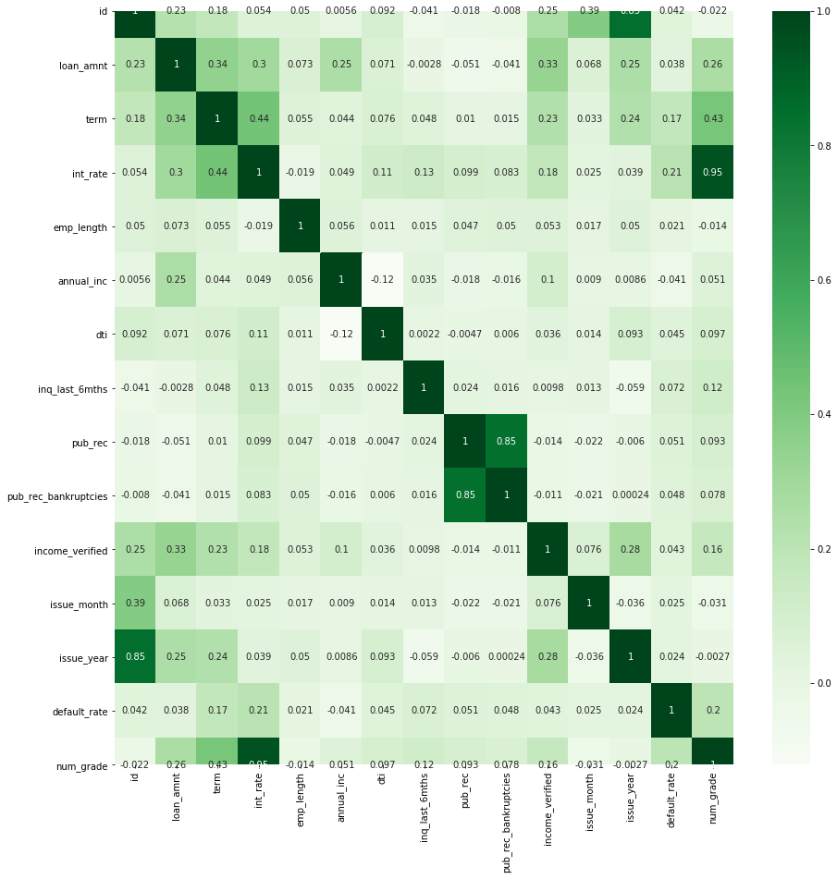
ANALYSIS
Correlation map

Slide 8
ANALYSIS

Slide 9
ANALYSIS

Slide 10
ANALYSIS

Slide 11
RECOMMENDATION

Slide 12
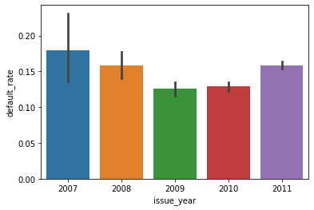
Interesting Fact
RECESSION FACTOR
Default by Year:
During the analysis it was observed that people tend to default more during a Recession/Financial Crisis.

